Slide 1
WHAT’S WRONG WITH THE EU:
problems and challenges
Prof. Dr. Mustafa Acar
Aksaray University &
Kırıkkale University, Turkey

Slide 2
plan
What’s the matter with the EU?
Sources of the problems
What can be done?

Slide 3
What’s the matter?
EU is in deep crisis: multi-dimensional problem
Economic
Political
Demographic
Cultural: social integration

Slide 4
Sources of the problem
Philosophical-historical: Ibn Khaldun, life-cycle of the civilizations..
Demographic: aging population
Economic: fiscal discipline, heavy debt burden, budget deficits, labor market regulations, stagnation..
Cultural: migration, social integration, racism
Political: leadership, instability

Slide 5
Philosophical-historical
Ibn Khaldun, life-cycle of the civilizations..
Civilizations are just like human beings…
They are not eternal
Collapse is inevitable
Hegemony is “mobile”
Laws of history and social change..

Slide 6
Demographic problem
Aging population
Median age: 43 (Turkey: 28)
Population is not increasing (share)
Implication: sustainability of the social security system (increasing dependency ratio => higher burden on working population => more resources to non-employed population)

Slide 7
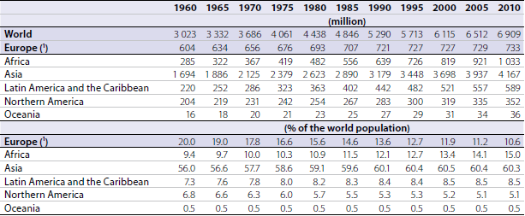
Population trends

Slide 8
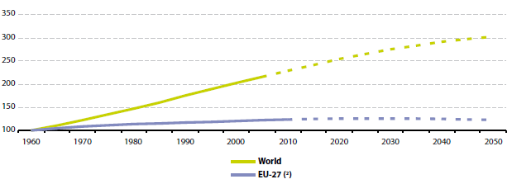
Population (1960=100)

Slide 9
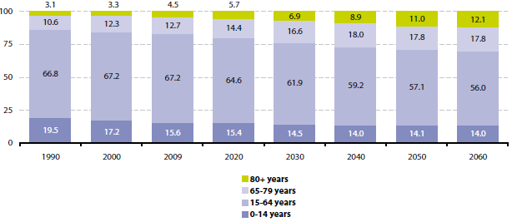
Population Structure by Major Age Groups, EU 27 (% of total population)

Slide 10
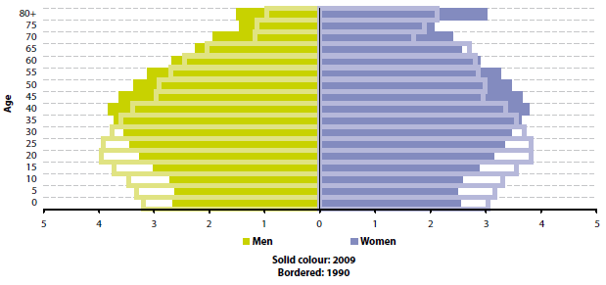
Population Pyramids, EU 27 (% of total population)

Slide 11
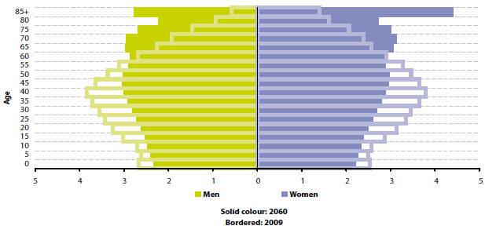
Population Pyramids, EU 27 (% of total population)

Slide 12
Change in the Share of Population Aged 65 Years or Over Between 1990 and 2009 (percentage point change)

Slide 13
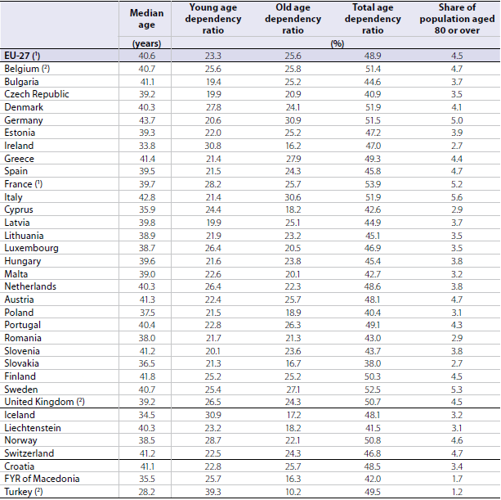
Population Age Structure Indicators, 2009

Slide 14
Economic problem
Deteriorating macro indicators
Lack of fiscal discipline
heavy debt burden
budget deficits
labor market regulations
stagnation..

Slide 15
Stagnation..
Greek problem!
Heavy debt burden
Financial volatility
Political instability
High budget deficits
Lower growth
Low potential output
High unemployment rates
Lack of fiscal union and
Coordination problems

Slide 16
Bad macro’s for EU (2011)
 | Real GDP Growth Rate (Volume) | Unemployment Rate | General Government Gross Debt (% of GDP) | General Government Deficit (% of GDP)
Greece | -6.9 | 17.7 | 165.3 | -9.1
Portugal | -1.6 | 12.9 | 107.8 | -4.2
Spain | 0.7 | 21.7 | 68.5 | -8.5
Ireland | 0.7 | 14.4 | 108.2 | -13.1
Italy | 0.4 | 8.4 | 120.1 | -3.9
Germany | 3.0 | 5.9 | 81.2 | -1.0
Latvia | 5.5 | 15.4 | 42.6 | -3.5
EU 27 | 1.5 | 9.7 | 82.5 | -4.5
EU 16 | 1.5 | 10.1 | 87.4 | -4.1

Slide 17
Cultural-social problem
Migration laws (are we going to allow “illegal migration”?)
social integration (homogenization vs. pluralism)
Nationalism-racism (neo-Nazi movements on the rise)
Be on the right side: moderate, democrat, pluralist; not radical, anti-democrat, racist, isolationist, xenophobic.

Slide 18
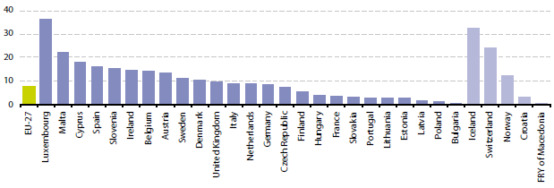
Immigrants, 2008 (per 1000 inhabitants)

Slide 19
Political Issues and Leadership
Political instability
Enlargement: vertical, horizental, or non?
Fiscal union: are we ready
Future of Euro-zone? Greek in or out?
..
All requires “leadership”
Strong
Charismatic
Courageous
Determined
Ready to take risk and pay the price

Slide 20
What to do?
Leadership: EU has to raise new leaders: charismatic, reformist, ready to pay the price of change
Aging population: nothing much to do except changing the migration laws
Immigration Issues: allow labor mobility, lift visa requirements, ready to share the welfare with “others..”
Integration problems: EU has to open doors for others, be tolerant, sensitive to plurality, freedoms..
Fiscal union: necessary if EU wants to survive
EU has to review “welfare state” and social security policies
Nationalist-racist trends: liberal-democratic values, tolerance, alliance of civilizations, dialogue, free trade

Slide 21
Thank You ☺ acar.aksaray.edu.tr acar70@gmail.com

