Slide 1
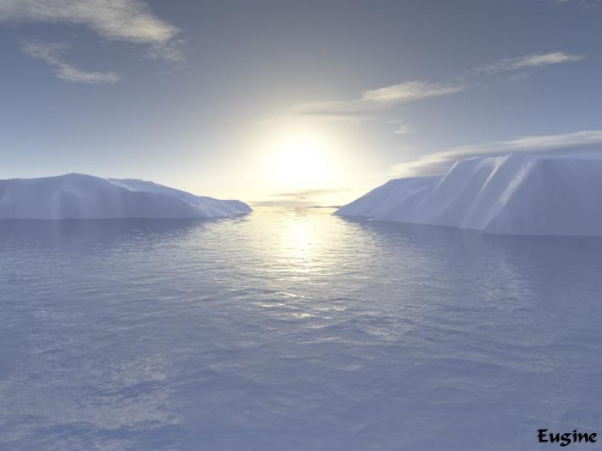
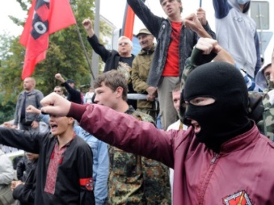
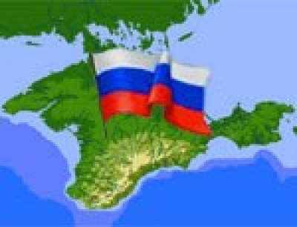
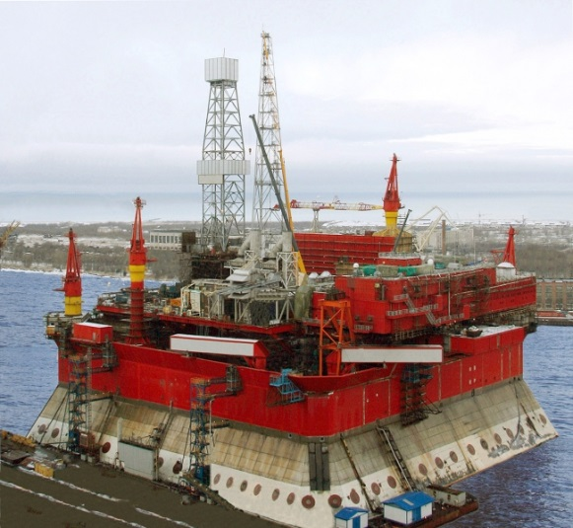
EU – Russia Energy Relations/
Ukraine Crisis
Elena Telegina
Director of the Institute of Geopolitics and Energy Security
Corresponding Member of Russian Academy of Sciences
Dean, International Energy Business Department
Doctor of Economics, Professor
Russian University of Oil and Gas

Slide 2
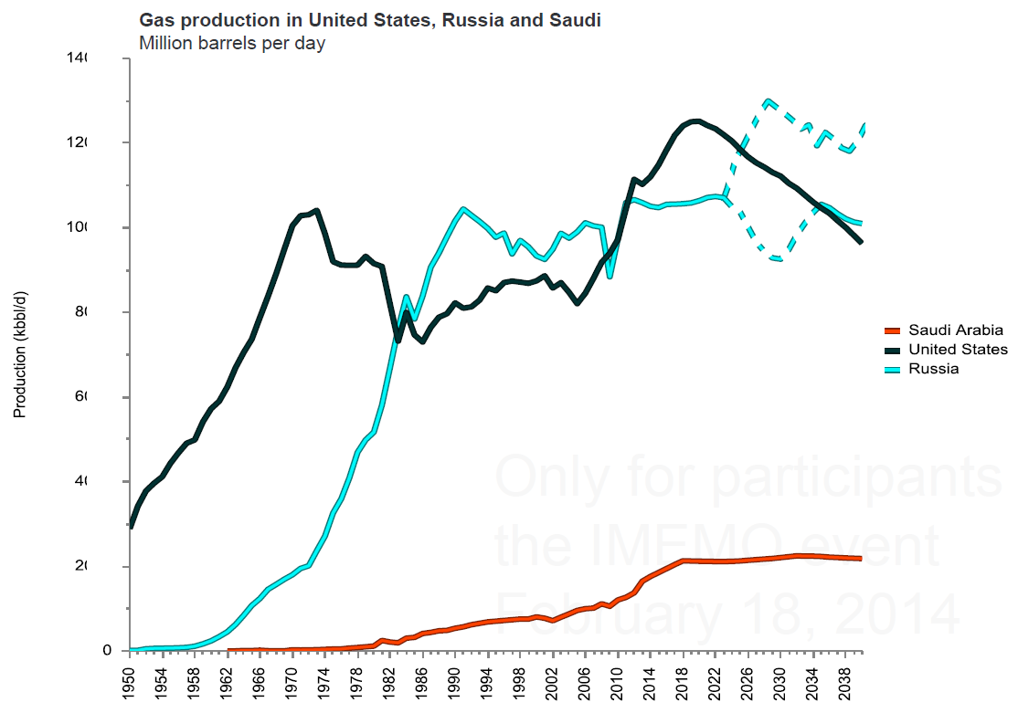
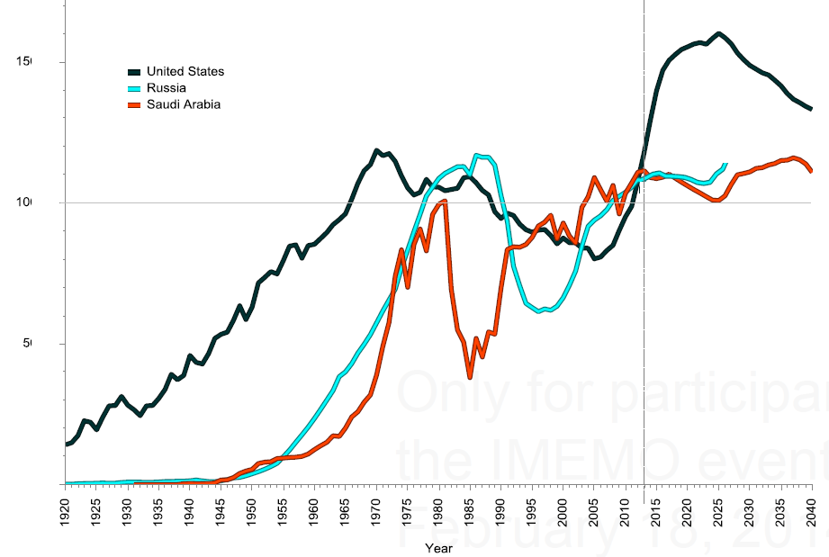
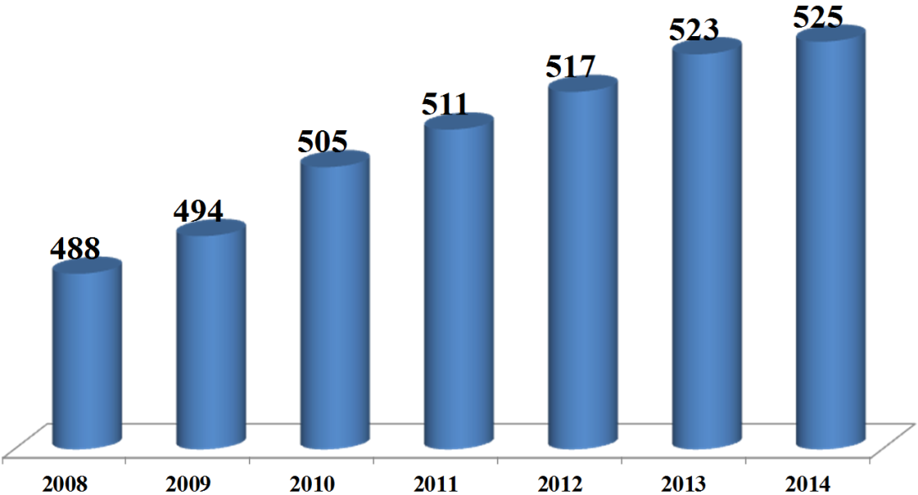
Gas production in Russia, bcm
Gas Production in the USA, Russia and Saudi Arabia,
1950-2038
Liquids Production in the USA, Russia and Saudi Arabia, mln bbl/day/ 1920-2040
Oil production in Russia, mln t
ENGIN, Rystad Energy
planned

Slide 3
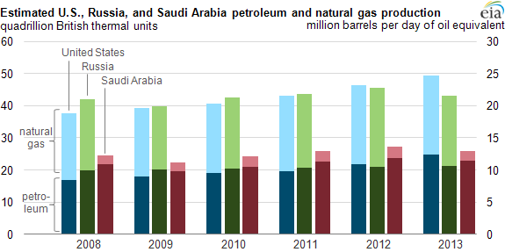

Slide 4
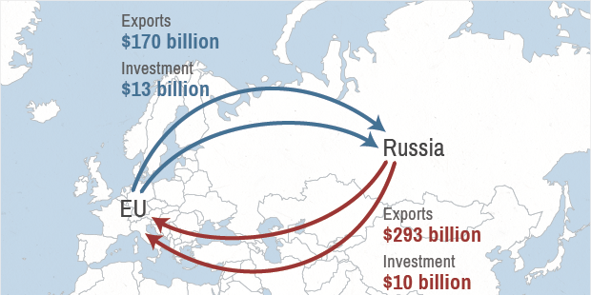
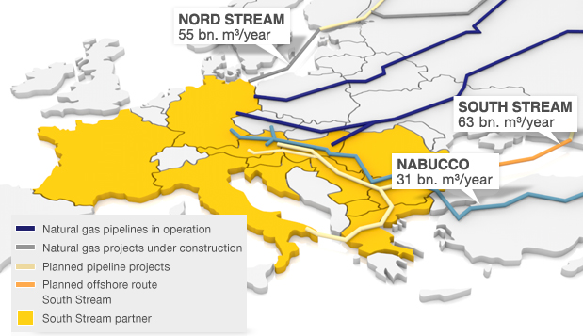
Russian gas in European countries
(% in energy balance)
Belgium
Netherlands
Switzerland
Romania
France
Italy
Germany
Ukraine
Hungary
Turkey
Austria
Greece
Estonia
Slovakia
Lithuania
Moldova
Latvia
Serbia
Bulgary
Chech Republic
Finland
Belorus
EU – Russia Economic Interdependence

Slide 5
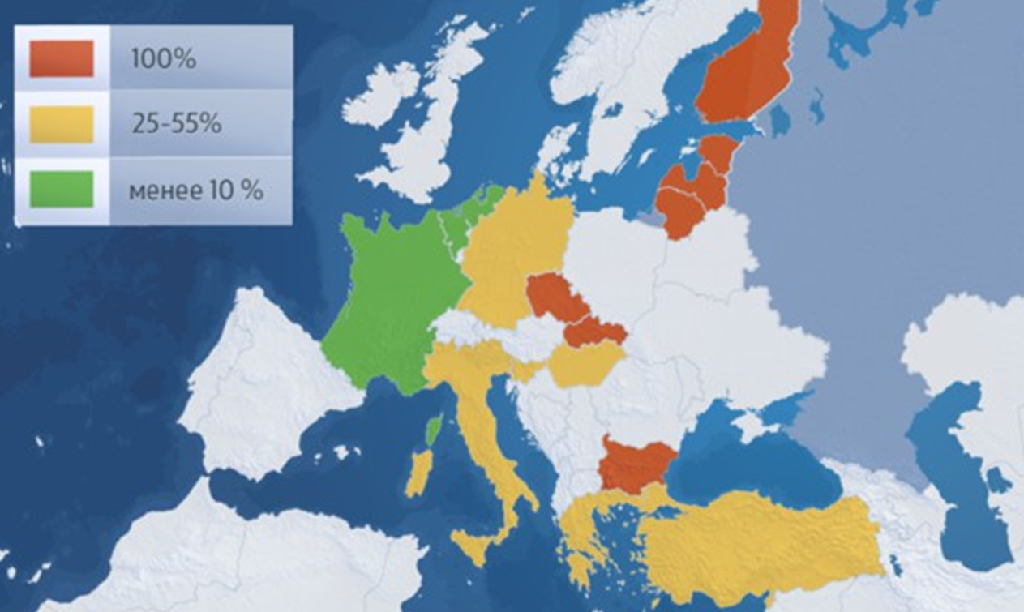
European dependence on Russian gas imports
15%
LESS
Ukranian Gas
Transportation System
Capacity, bcm
Length, th km
Amortization, %
23%
51%
Structure of Russian gas exports to Europe, %
9%
Ukraine
Belarus
Blue Stream
North Stream
Finland

Slide 6
Russian Gas Export Routes to Europe, bcm/year
Route | Capacity bcm/year | Volume 2012 | Spare capacity
Ukraine | 72 | 63 | 9
Nord Stream | 56 | 22 | 34
Belarus | 38 | 27 | 11
Baltics/Finland | 5 | 4 | 1
Total with Ukraine | 170 | 116 | 55
Total without Ukraine | 98 | 53 | 46
In 2013, the European Union consumed about 462 bcm of natural gas.
About 156 bcm was domestic EU production, one third of total needs.
Russia exported 139 bcm (27% of total EU exports) to European markets in 2013 .
Norway supplied 23% of gas, Algeria 8%.
Alternative sources are LNG from Qatar and the United States; not yet ready.
EU natural gas demand is stagnant or falling, with a potential for a rebound.
Source: Gazprom, Øystein Noreng, ICEED(Norway), ENGIN

Slide 7
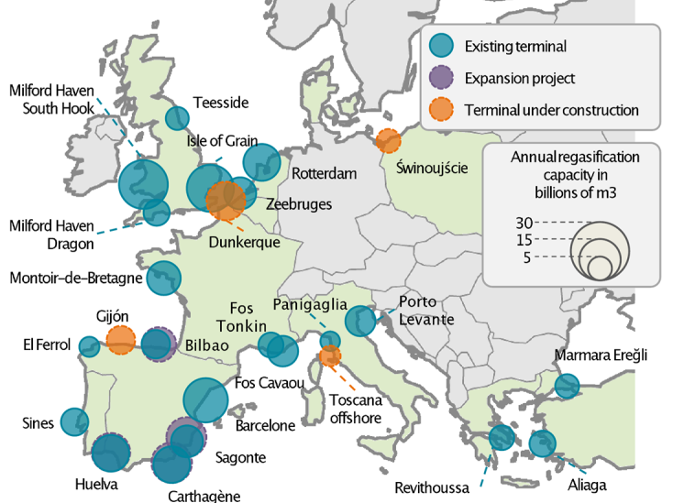
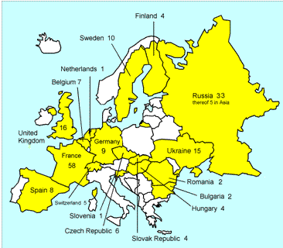
Existing and planned LNG terminals in Europe
Nuclear plants in EU and Russia

Slide 8
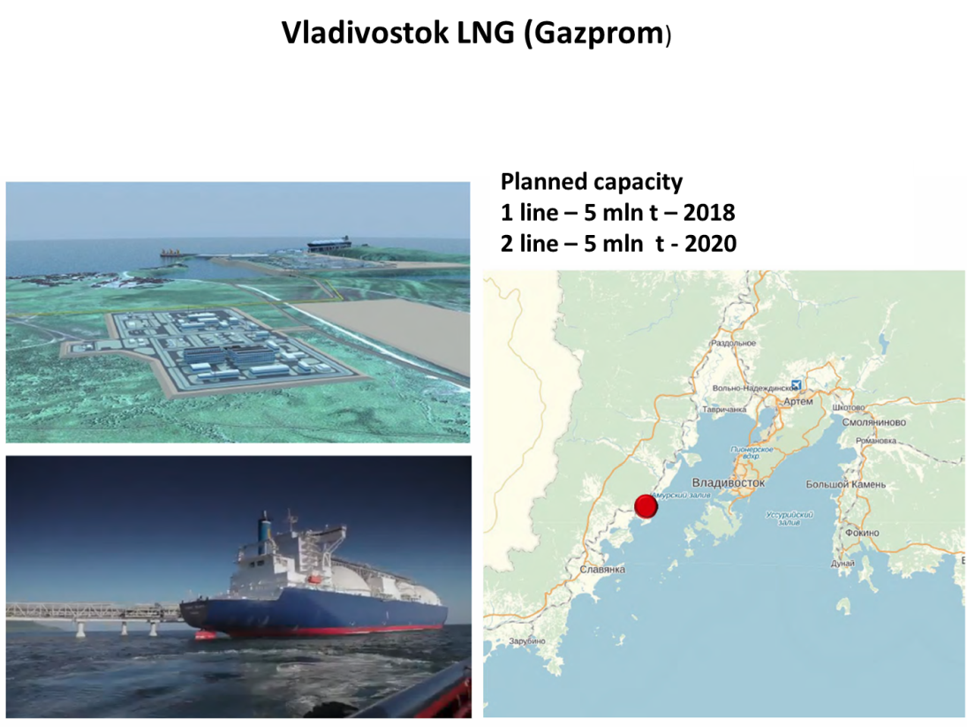
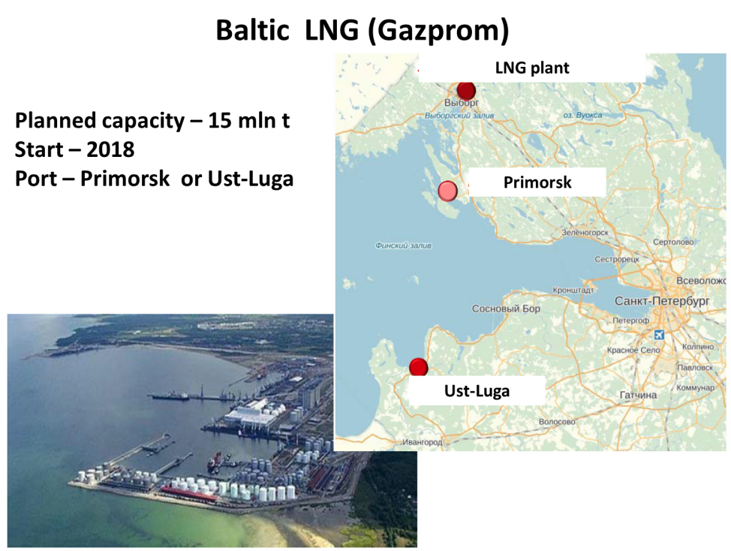
New LNG Projects
LNG Projects in the USA
Preliminary application
Additional application
(gas deliveries not earlier than 2017)
Confirmed (gas deliveries late 2015)

Slide 9
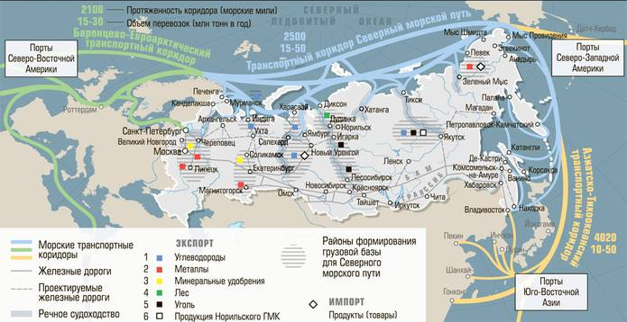
Switch to the East
Length in miles
Deliveries (mln t per year)
US North Eastern
Ports
US North Western
Ports
Russian LNG Projects – 1 existing and 4 under construction
Yamal (NOVATEK, 15 mln t)
Baltic (Gazprom, 15 mln t)
South East Asian
Ports
Vladivostok (Gazprom, 10-15 mln t)
Sakhalin 1 (Rosneft, 5+ mln t)
Sakhalin 2 (Gasprom, 10 mln t plus 5 mln t potential extention)
Planned exports up to 68 bcm/year
Engin, www.expert.ru

Slide 10
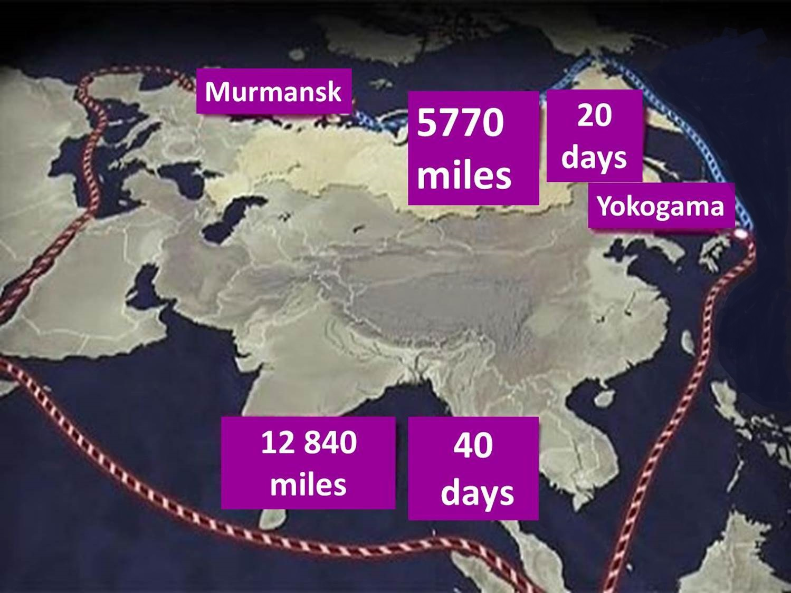

Slide 11
Northern Sea Route vs Southern Sea Route
Northern Sea Route
20 days
Hamburg
China
Shanghai
Southern Sea Route

Slide 12
Information Centers
Deep Sea Ports
Field exploration
Shale Oil
Fishery Fields
Gas
Oil
Planned
Routes
Offshore Platforms
Hydro
Wind

Slide 13
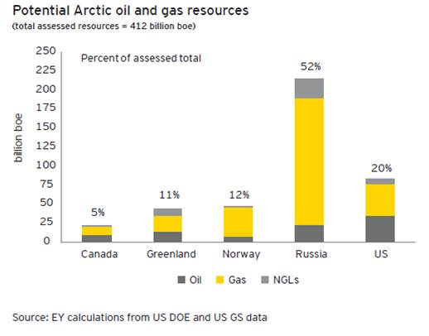

Slide 14
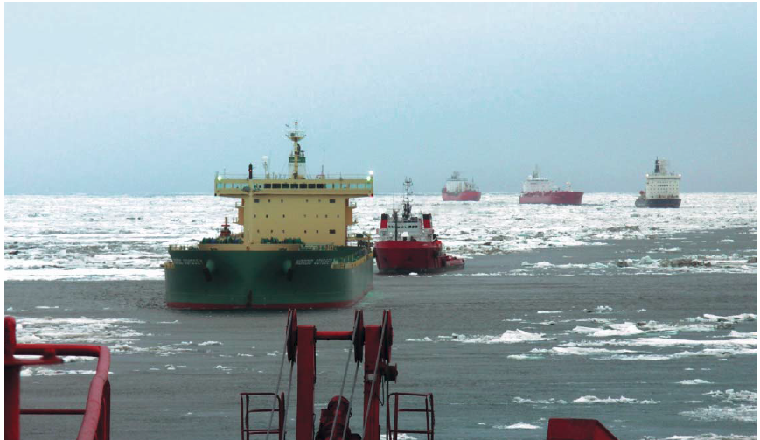
Northern Sea Route, 2012

Slide 15
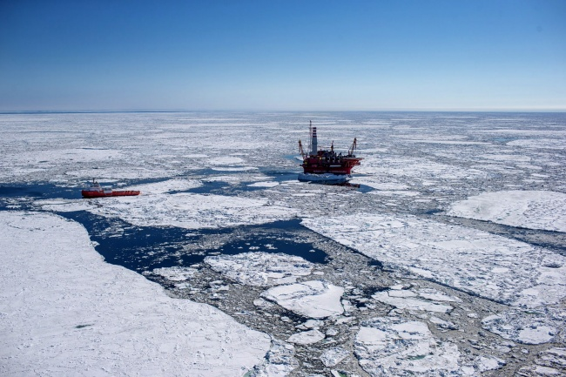
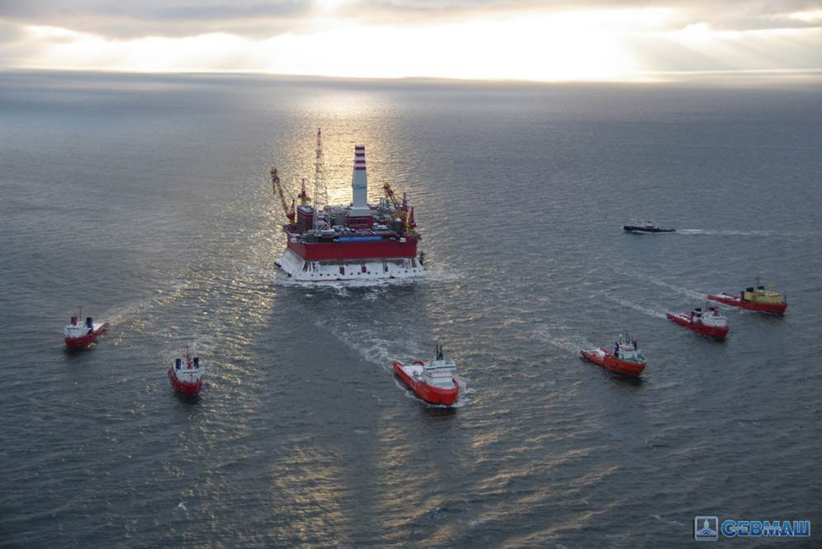
Prirazlomnaya Platform
Transportation to Murmansk
The Prirazlomnaya oil platform has started production in the icy waters of the Pechora Sea early 2014.

Slide 16
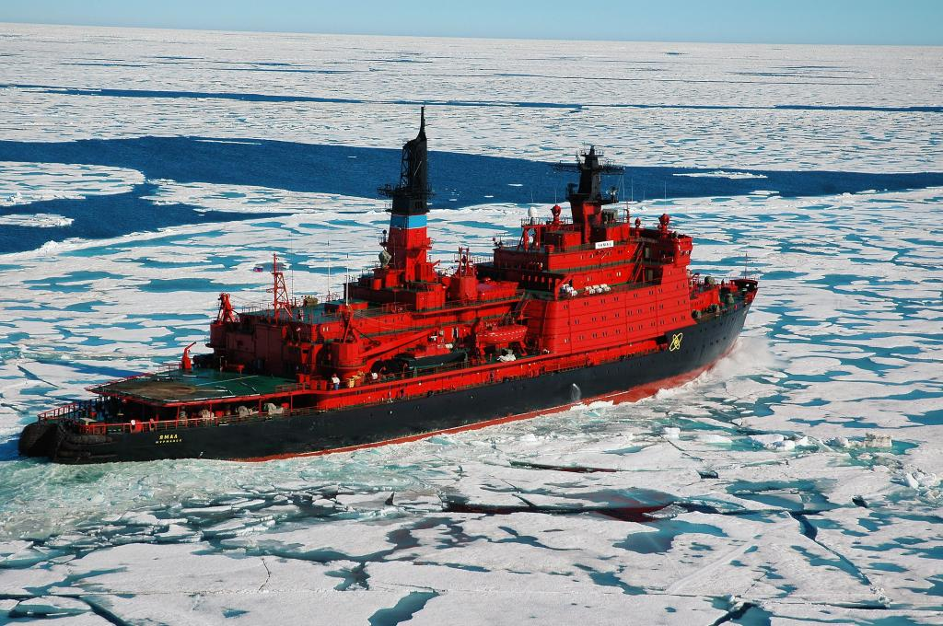
10 ice-breakers in the world, all designed and/or built in the USSR or Russia.
Six of them - in Russia.
Four - in the Northern Sea Route.

Slide 17
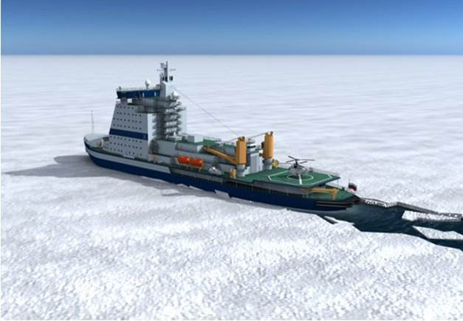
Three new nuclear vessels with ice-breaking capacity up to 3,5 m will be built in Russia in 2017 - 2020 .

Slide 18
Russia is highly dependent on oil and gas sales to Europe. Investment in the Baltic Sea Nord Stream and the planned Black Sea South Stream pipelines indicate Russian intentions to circumvent Ukraine to secure market access.
Russia is an important export market for the European industry with substantial direct investment in Russian industry.
For the EU: 1/The gain of political influence should be weighed against the cost of supporting Ukraine’s economy; 2/ The risk for Europe is to be left with the bill for Ukraine, while the US will gain political influence;3/ The EU Commission is US-friendly and critical to Russia.
In case of US success in dominancy, isolated Russia and China would be driven together, possibly with Iran as a third party, constituting an adversary trade bloc in Eurasia.
Being the world’s largest oil and natural gas producer Russia started to re-direct energy flows to Asia Pacific Region. The APR market for exports of Russian heating coal, oil and natural gas will grow dramatically in the coming decade.
Infrastructural independence is becoming the top priority for Russian energy security. Therefore existing routes and passages for trans-border transportation have been re-newed and extended.
New markets for Russian energy products demand new infrastructural construction, that is, LNG terminals and ice-breakers.
The use of nuclear ice breakers as Russian strategic arctic transportation advantage during relatively short navigation period (up to 6 months) makes the Northern Sea Route promising and challenging area for international co-operation.

Slide 19
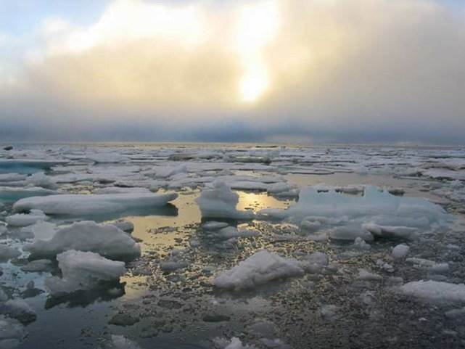
Thank you!

