Slide 1
LATVIA transport and logistics
Baltic forum , jurmala, may 23, 2014
Kaspars Ozoliņš
State Secretary
Ministry of Transport of the Republic of Latvia

Slide 2
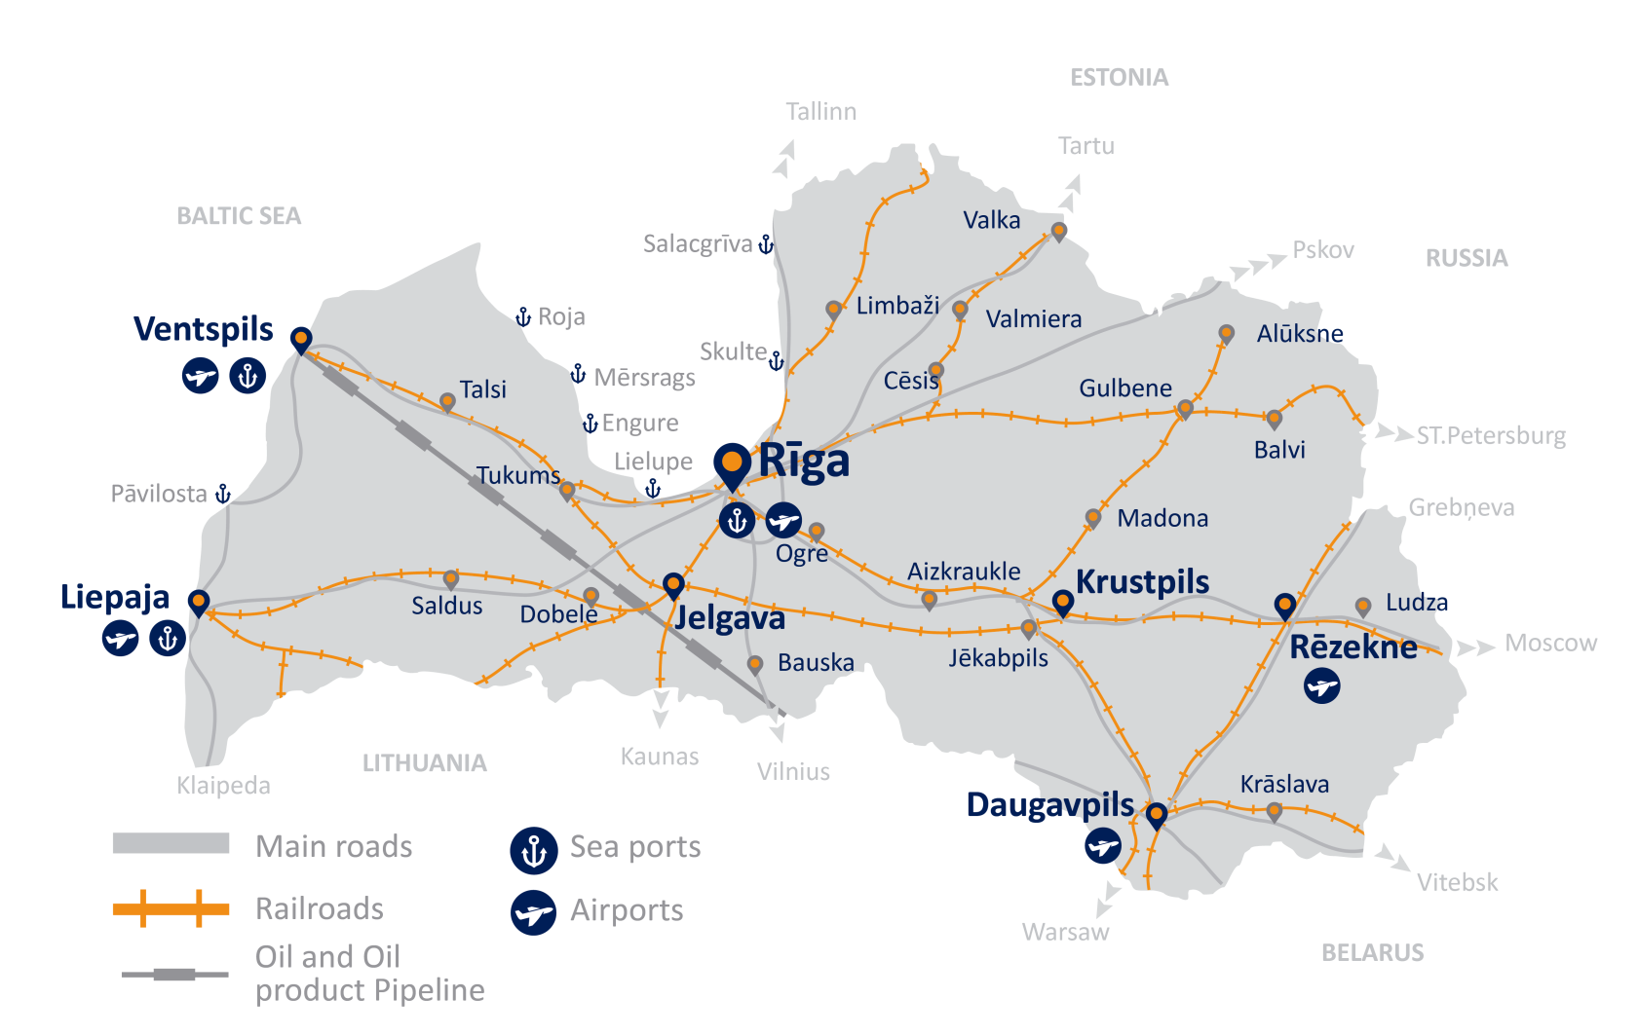
Latvia – transport infrastructure
582 +534 mln EUR
Investments in Roads
Ludza – Terehova
Riga (Tinuzhi) – Koknese
286 + 557 mln EUR
Investments in Railways
Skriveri – Krustpils double track
Bolderaja 2 (Krievu sala)
East-West Electrification
1,3 bln EUR - RAIL BALTICA

Slide 3
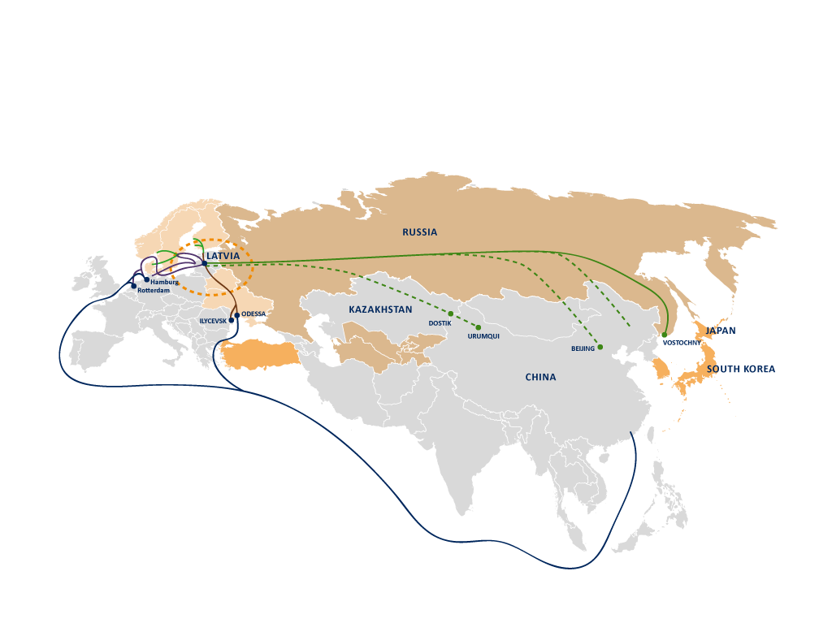
General overview - MULTIMODAL CORRIDORS
18 days
Moscow
15 days
Almaty
35 days

Slide 4
THANK YOU FOR YOUR ATTENTION!
Kaspars Ozoliņš
State Secretary
Ministry of Transport
www.sam.gov.lv

