Slide 1
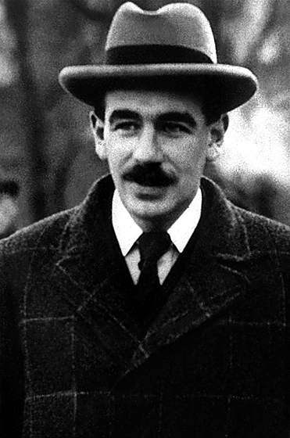
John Maynard Keynes, Economic Possibilities for our Grandchildren, (1930)
Greed and envy demand continuous and limitless economic growth of a material kind, without proper regard for conservation, and this type of growth cannot possibly fit into a finite environment. (Ernest Schumacher, Small is Beautiful: Economics as if People Mattered , 1973)
When the accumulation of wealth is no longer of high social importance, there will be great changes in the code of morals. We shall be able to rid ourselves of many of the pseudo-moral principles which have hag-ridden us for two hundred years, by which we have exalted some of the most distasteful of human qualities into the position of the highest virtues. …
But beware! The time for all this is not yet. For at least another hundred years we must pretend to ourselves and to every one that fair is foul and foul is fair; for foul is useful and fair is not.

Slide 2
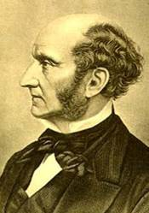
We have created an economy which has ended up running counter to the values on which it was nominally based, and to its own objectives. (N.Sarkozy, speech in WEF, Davos, January 27, 2010)
I confess I am not charmed with the ideal of life held out by those who think that the normal state of human beings is that of struggling to get on; that the trampling, crushing, elbowing, and treading on each other's heels, which form the existing type of social life, are the most desirable lot of human kind, or anything but the disagreeable symptoms of one of the phases of industrial progress.
John Stuart Mill, Principles of Political Economy, Book IV, Chapter VI, “Of the Stationary State”, (1848)

